Slide 1
A remark on the subsequence problem for arc-annotated sequences with pairwise nested arcs
Peter Damaschke
Information Processing Letters, Vol. 100, pp. 64-68, 2006
Presenter: Yung-Hsing Peng
Date: Apr. 02, 2008

Slide 2
Abstract
The Arc-Preserving Subsequence (APS) problem appears in the comparison of RNA structures in computational biology. Given two arc-annotated sequences of length n and m < n, APS asks if the shorter sequence can be obtained from the longer one by deleting certain elements along with their incident arcs. It is known that APS with pairwise nested arcs can be solved in O(mn) time. We give an algorithm running in O(m²+n) time in the worst case, actually it is even faster in particular if the shorter sequence has many arcs. The result may serve as a building block for improved APS algorithms in the general case.

Slide 3
Arc-Annotated Sequences I
Pairwise nested
G
G
U
G
C
A
C
A
G
C
C
U
Nested
G
G
U
G
C
A
C
A
G
C
C
U
Pairwise Crossing
G
G
U
G
C
A
C
A
G
C
C
U

Slide 4
Arc-Annotated Sequences II
Chain
G
G
U
G
C
A
C
A
G
C
C
U
Crossing
G
G
U
G
C
A
C
A
G
C
C
U
G
G
U
G
C
A
C
A
G
C
C
U
Plain

Slide 5
The Subsequence Problem
G
G
U
G
C
A
C
A
G
C
C
U
Sequence S
G
G
C
A
C
C
U
Sequence T
Problem: Is T a subsequence in S?
This problem can be solved with an O(n+m)-time greedy algorithm. (n=|S|, m=|T|)

Slide 6
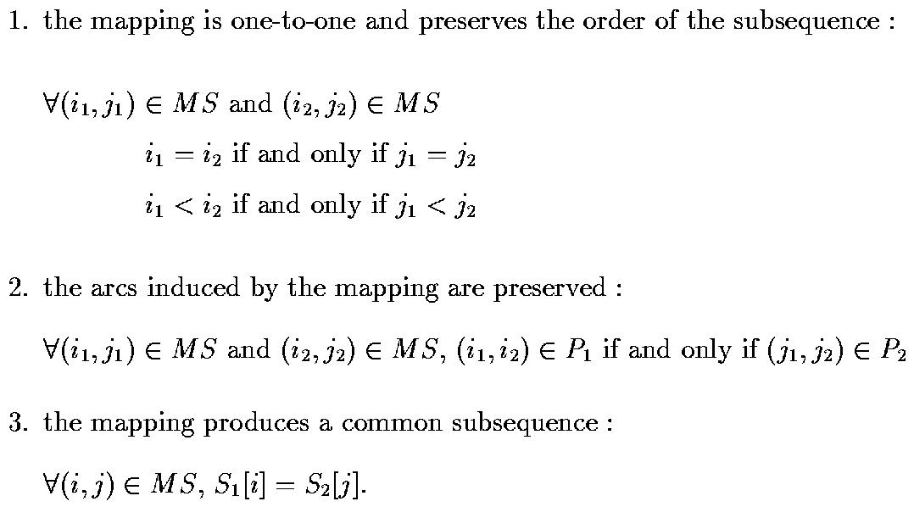
The Arc-Preserving Subsequence
Given two arc-annotated sequences (S₁, P₁) and (S₂, P₂), any arc-preserving subsequence of them must satisfy:
For each (i, j) in MS, map S₁[i] with S₂[j]

Slide 7
The Arc-Preserving Subsequence Problem
G
G
U
G
C
A
C
A
G
C
C
U
Sequence (S, P)
Yes!
G
G
C
A
C
C
U
Sequence (T, Q)
No!
G
G
C
A
C
C
U
Problem: Is (T, Q) an arc-preserving subsequence in (S, P)?
The needed time for solving this problem depends on various restriction on arcs.

Slide 8
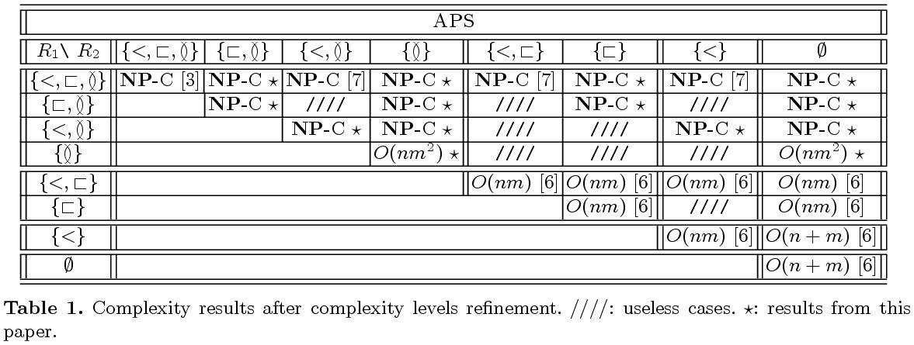
Complexities of APS problems
p-crossing
p-nested
p-chain
plain
Extracted from “G. Blin, G. Fertin, R. Rizzi, S. Vialette, What makes the ARC-PRESERVING SUBSEQUENCE problem hard?, in: 1st International Workshop on Bioinformatics Research and Applications IWBRA 2005, in: Lecture Notes in Computer Science, vol. 3515, Springer, Berlin, 2005, pp. 860-868”
In this paper, the authors improve the case of pair-wise nested arcs.

Slide 9
A Trivial Greedy Algorithm
G
G
U
G
C
A
C
A
G
C
C
U
Sequence (S, P)
G
G
C
A
C
C
U
Sequence (T, Q)
Idea: The outer, the better. Treat arcs in Q as break points.
However, it’s not correct. (Do you know why?)

Slide 10
Conflicts in the Greedy Algorithm
G
G
U
G
C
A
C
A
G
C
C
U
Sequence (S, P)
Wrong!
G
G
C
A
C
C
U
Sequence (T, Q)
Bug: some arcs in P may be mis-picked
Therefore, the correct greedy algorithm should be written as
The outer, the better, if there are no conflicts.
How can we deal with these conflicts?

Slide 11
Reduction to the CFPE Problem
CFPE: Context-Free Prefix Embedding
G
G
U
G
C
A
C
A
G
C
C
U
O(n)-time transformation
ANS
G
-
-
G
U
-
G
C
A
S₁
U
C
C
-
G
A
C
-
-
S₂
T₁
T₂
Goal: Find the shortest prefix such that T₁ and T₂ can be embedded with no common positions (conflicts).
G
G
C
A
C
C
U

Slide 12
Dynamic Programming for CFPE
E(x₁, x₂, y) = 1, if T₁[1~x₁] and T₂[1~x₂] can be embedded in S₁[1~y] and S₂[1~y], respectively.
Otherwise, we have E(x₁, x₂, y) = 0
Hint: If E(x₁, x₂, y – 1) = 1, then E(x₁, x₂, y) must be 1. We should consider E(x₁, x₂, y – 1) = 0.
Formula: E(x₁, x₂, y) = E(x₁, x₂, y – 1) + 1, for
(1) E(x₁ – 1, x₂, y – 1) = 1 and T₁[x₁] = S₁[y], or
(2) E(x₁, x₂ – 1, y – 1) = 1 and T₂[x₂] = S₂[y].
There are at most |T₁||T₂| switches from 0 to 1.
E(|T₁|, |T₂|, y) can be determined with O(|T₁||T₂| + y) time. (see related proofs in this paper).

Slide 13
Overview of the Algorithm
G
G
U
G
C
A
C
A
G
C
C
U
O(n)-time transformation
shortest
(CFPE)
G
-
-
G
U
-
G
C
A
S₁
U
C
C
-
G
A
C
-
-
S₂
Recursively check the rest (inner) part.
Total Time: O(m² + n)
T₁
T₂
G
G
C
A
C
C
U

Slide 14
Summary
APS for arc-annotated sequences with pairwise nested arcs is solvable in time O(m² + n).
Corollary: APS for arc-annotated sequences with pairwise crossing arcs is solvable in time O(m³ + mn). (according to Blin’s paper)
Epilogue:
(1)The longest arc-preserving common subsequence (LAPCS)? (very difficult)
(2)Edit distance with operation on arcs? (very difficult, too)

